Slide 1
Modeling with UML #1

Slide 2
Outline of this Class
Use case diagrams
  Describe the functional behavior of the system as seen by the user
Class diagrams
  Describe the static structure of the system: Objects, attributes, associations
Sequence diagrams
  Describe the dynamic behavior between objects of the system
Statechart diagrams
  Describe the dynamic behavior of an individual object
Activity diagrams
  Describe the dynamic behavior of a system, in particular the workflow.
Notes:
We provided already a basic overview of the notations:
Use case diagrams
Class diagrams
Sequence diagrams, statechart diagrams
We will now go int more detail and cover two additional notations as well, sequence diagrams and activity diagrams

Slide 3




What is UML? Unified Modeling Language
Convergence of different notations used in object-oriented methods, mainly
    OMT (James Rumbaugh and collegues), OOSE (Ivar Jacobson), Booch (Grady Booch)
They also developed the Rational Unified Process, which became the Unified Process in 1999
Developed the Booch method (“clouds”), ACM Fellow 1995, and IBM Fellow 2003
http://www.booch.com/
25 year at GE Research, where he developed OMT, joined (IBM) Rational in 1994, CASE tool OMTool
At Ericsson until 1994, developed use cases and the CASE tool Objectory, at IBM Rational since 1995, http://www.ivarjacobson.com

Slide 4

UML
Nonproprietary standard for modeling systems
Current Version: UML 2.2
  Information at the OMG portal http://www.uml.org/
Commercial tools:
  Rational (IBM),Together (Borland), Visual Architect (Visual Paradigm), Enterprise Architect (Sparx Systems)
Open Source tools http://www.sourceforge.net/
  ArgoUML, StarUML, Umbrello (for KDE), PoseidonUML
Example of research tools: Unicase, Sysiphus
  Based on a unified project model for modeling, collaboration and project organization
  http://unicase.org
  http://sysiphus.in.tum.de/

Slide 5
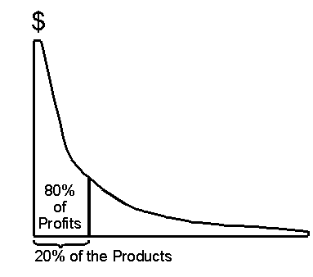

UML: First Pass
You can solve 80% of the modeling problems by using 20 % UML
We teach you those 20%
80-20 rule: Pareto principle
Vilfredo Pareto, 1848-1923
Introduced the concept of Pareto Efficiency,
Founder of the field of microeconomics.

Slide 6
UML First Pass (covered in Last Lecture)
Use case diagrams
  Describe the functional behavior of the system as seen by the user
Class diagrams
  Describe the static structure of the system: Objects, attributes, associations
Sequence diagrams
  Describe the dynamic behavior between objects of the system
Statechart diagrams
  Describe the dynamic behavior of an individual object
Activity diagrams
  Describe the dynamic behavior of a system, in particular the workflow.
Notes:
Statechart diagrams
Describe the dynamic behavior of an individual object (essentially a finite state automaton)
Activity Diagrams
Model the dynamic behavior of a system, in particular the workflow (essentially a flowchart)

Slide 7
UML Basic Notation: First Summary
UML provides a wide variety of notations for modeling many aspects of software systems
In the first lecture we concentrated on:
  Functional model: Use case diagram
  Object model: Class diagram
  Dynamic model: Sequence diagrams, statechart
Now we go into a little bit more detail…
Notes:
Powerful, but complex language
Can be misused to generate unreadable models
Can be misunderstood when using too many exotic features

Slide 8
UML Use Case Diagrams
Used during requirements elicitation and analysis to represent external behavior (“visible from the outside of the system”)
An Actor represents a role, that is, a type of user of the system
Passenger
A use case represents a class of functionality provided by the system
Use case model:
  The set of all use cases that completely describe the functionality of the system.
PurchaseTicket

Slide 9
Actors
An actor is a model for an external entity which interacts (communicates) with the system:
  User
  External system (Another system)
  Physical environment (e.g. Weather)
An actor has a unique name and an optional description
Examples:
  Passenger: A person in the train
  GPS satellite: An external system that provides the system with GPS coordinates.
Passenger
Optional
Description
Name

Slide 10
Use Case
• A use case represents a class of functionality provided by the system
• Use cases can be described textually, with a focus on the event flow between actor and system
• The textual use case description consists of 6 parts:
  Unique name
  Participating actors
  Entry conditions
  Exit conditions
  Flow of events
  Special requirements.
PurchaseTicket

Slide 11
Textual Use Case
Description Example
Passenger
PurchaseTicket
1. Name: Purchase ticket
2. Participating actor: Passenger
3. Entry condition:
Passenger stands in front of ticket distributor
Passenger has sufficient money to purchase ticket
4. Exit condition:
Passenger has ticket
5. Flow of events:
  1. Passenger selects the number of zones to be traveled
  2. _x0008_Ticket Distributor displays the amount due
  3. Passenger inserts money, at least the amount due
  4. Ticket Distributor returns change
  5. Ticket Distributor issues ticket
6. Special requirements: None.
Notes:
Question: Anything missing? Answer: Exceptional cases!
Use cases represent functionality of the system
All use cases need to be described for the model to be useful
Use case diagrams are useful as an index into the use cases
The Textual Use case descriptions provide meat of model, not the use case diagrams.

Slide 12
Uses Cases can be related
Extends Relationship
  To represent seldom invoked use cases or exceptional functionality
Includes Relationship
  To represent functional behavior common to more than one use case.

Slide 13
The <<extends>> Relationship
<<extends>> relationships model exceptional or seldom invoked cases
The exceptional event flows are factored out of the main event flow for clarity
The direction of an <<extends>> relationship is to the extended use case
Use cases representing exceptional flows can extend more than one use case.
Passenger
PurchaseTicket
<<extends>>
<<extends>>
<<extends>>
OutOfOrder
<<extends>>
TimeOut
Cancel
NoChange

Slide 14
The <<includes>> Relationship
<<includes>> relationship represents common functionality needed in more than one use case
<<includes>> behavior is factored out for reuse, not because it is an exception
The direction of a <<includes>> relationship is to the using use case (unlike the direction of the <<extends>> relationship).
Passenger
PurchaseMultiCard
PurchaseSingleTicket
<<includes>>
<<includes>>
<<extends>>
CollectMoney
<<extends>>
<<extends>>
NoChange
Cancel
Cancel

Slide 15
Class Diagrams
Class diagrams represent the structure of the system
Used
  during requirements analysis to model application domain concepts
  during system design to model subsystems
  during object design to specify the detailed behavior and attributes of classes.
TarifSchedule
Trip
Table zone2price
Enumeration getZones()
Price getPrice(Zone)
zone:Zone
Price: Price
*
*

Slide 16
Classes
Type
TarifSchedule
Table zone2price
Enumeration getZones()
Price getPrice(Zone)
Name
TarifSchedule
Attributes
Signature
zone2price
getZones()
getPrice()
Operations
TarifSchedule
A class represents a concept
A class encapsulates state (attributes) and behavior (operations)
Each attribute has a type
Each operation has a signature
The class name is the only mandatory information

Slide 17
Instances
tarif2006:TarifSchedule
:TarifSchedule
zone2price = {
{‘1’, 0.20},
{‘2’, 0.40},
{‘3’, 0.60}}
zone2price = {
{‘1’, 0.20},
{‘2’, 0.40},
{‘3’, 0.60}}
An instance represents a phenomenon
The attributes are represented with their values
The name of an instance is underlined
The name can contain only the class name of the instance (anonymous instance)

Slide 18
Actor vs Class vs Object
Actor
  An entity outside the system to be modeled, interacting with the system (“Passenger”)
Class
  An abstraction modeling an entity in the application or solution domain
  The class is part of the system model (“User”, “Ticket distributor”, “Server”)
Object
  A specific instance of a class (“Joe, the passenger who is purchasing a ticket from the ticket distributor”).
Notes:
What is the difference between an actor, a class and an instance?

Slide 19
Associations
TarifSchedule
TripLeg
Enumeration getZones()
Price getPrice(Zone)
*
Price
Zone
*
Associations denote relationships between classes
The multiplicity of an association end denotes how many objects the instance of a class can legitimately reference.

Slide 20
1-to-1 and 1-to-many Associations
Country
1
1
City
name:String
name:String
1-to-1 association
Point
Polygon
*
x: Integer
draw()
y: Integer
1-to-many association

Slide 21
Many-to-Many Associations
Company
*
*
StockExchange
tickerSymbol
Notes:
A stock exchange lists many companies each of them uniquely identifed by a ticker symbol used at that stock exchange.
A company can be listed on more than one stock exchange, using the same ticker symbol.
Mercedes Benz is an example for a company listed on more than one stock exchange: Frankfurt and NYSE.
Does it have two different Ticker symbols?
Something not clear here: What happens if the company cannot have the same ticker symbol on two different stock exchanges?

Slide 22
From Problem Statement To Object Model
Problem Statement: A stock exchange lists many companies. Each company is uniquely identified by a ticker symbol
Class Diagram:
StockExchange
*
*
Company
Lists
tickerSymbol

Slide 23
From Problem Statement to Code
Pr
oblem Statement
:
A
stock exchange lists many companies.
Each company is identified by a ticker symbol
Class Diagram:
*
*
Company
StockExchange
Lists
tickerSymbol
Java Code
public class StockExchange
{
private Vector m_Company = new Vector();
Associations
are mapped to
Attributes!
};
public class Company
{
public int m_tickerSymbol;
private Vector m_StockExchange = new Vector();
};

Slide 24
Aggregation
An aggregation is a special case of association denoting a “consists-of” hierarchy
The aggregate is the parent class,
the components are the children classes
Exhaust system
1
0..2
Muffler
Tailpipe
diameter
diameter
A solid diamond denotes composition: A strong form of aggregation where the life time of the component instances is controlled by the aggregate. That is, the parts don’t exist on their won (“the whole controls/destroys the parts”)
TicketMachine
3
ZoneButton
Notes:
Example for composition: Bill of Material

Slide 25
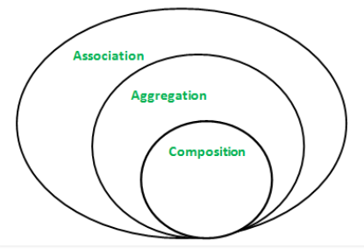
Association example

Slide 26
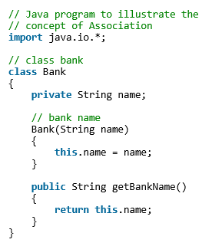
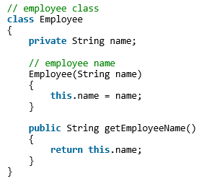
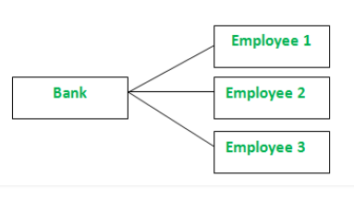
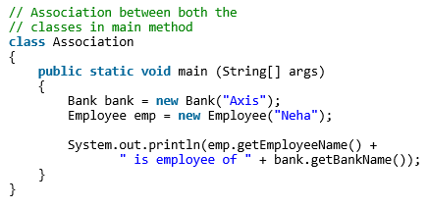
Association example

Slide 27
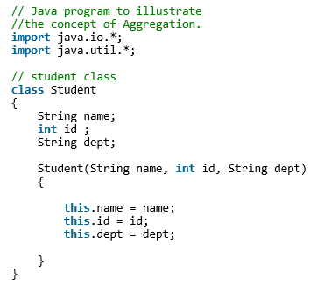
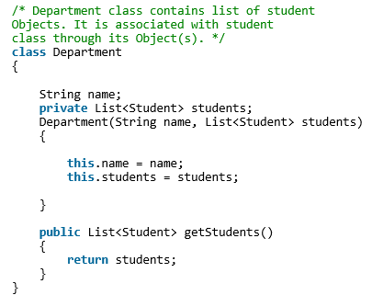
Aggregation example

Slide 28
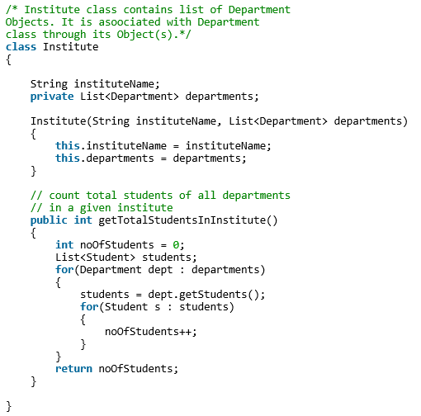
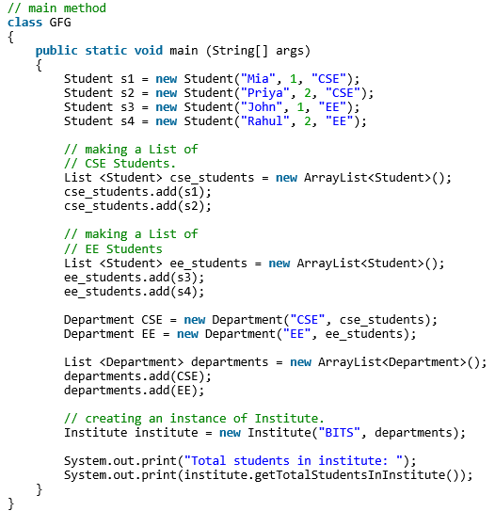
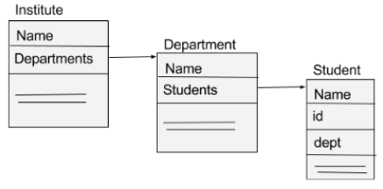
Aggregation example #2

Slide 29
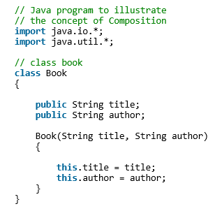
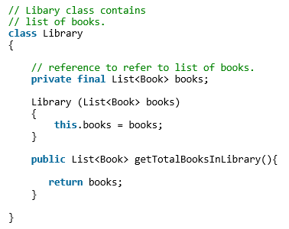
Composition example

Slide 30
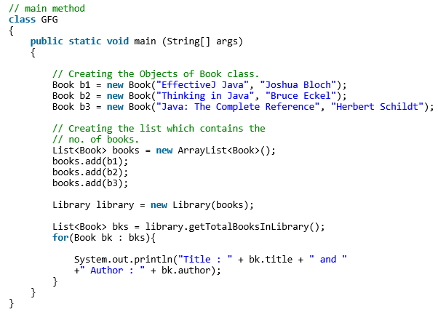
Composition example #2

Slide 31
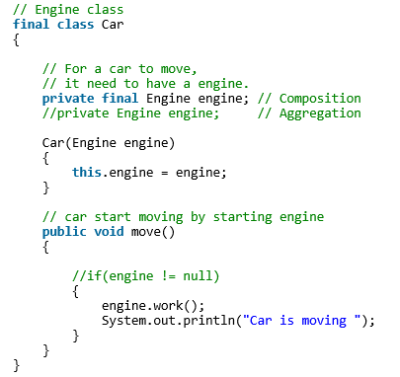
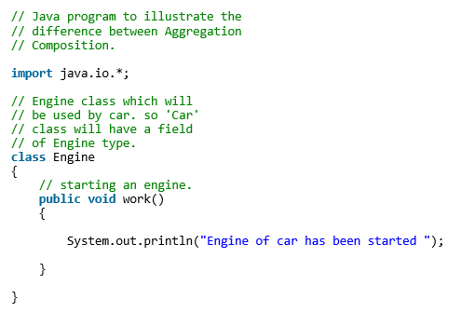
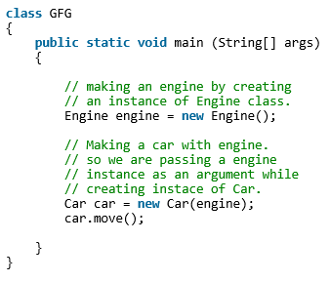
Aggregation vs Composition

Slide 32
Qualifiers
Without qualification
1
*
File
Directory
filename
With qualification
1
0..1
Directory
filename
File
Qualifiers can be used to reduce the multiplicity of an association
Notes:
In this case, filename is a qualifier attached to Directory

Slide 33
Qualification: Another Example
Company
*
Lists
*
StockExchange
tickerSymbol
*
Lists
1
*
Company
StockExchange
tickerSymbol

Slide 34
Inheritance
Button
CancelButton
ZoneButton
Inheritance is another special case of an association denoting a “kind-of” hierarchy
Inheritance simplifies the analysis model by introducing a taxonomy
The children classes inherit the attributes and operations of the parent class.
Notes:
Later we will also see how inheritance allows the reuse of solutions (implementation and specification inheritance)

Slide 35
Packages
Packages help you to organize UML models to increase their readability
We can use the UML package mechanism to organize classes into subsystems
Any complex system can be decomposed into subsystems, where each subsystem is modeled as a package.
Account
Bank
Customer
Notes:
Packages are the grouping construct with

Slide 36
Object Modeling in Practice
Foo
Amount
CustomerId
Deposit()
Withdraw()
GetBalance()
Class Identification: Name of Class, Attributes and Methods
Is Foo the right name?

Slide 37


Object Modeling in Practice: Brainstorming
“Dada”
Foo
Amount
Amount
CustomerId
CustomerId
Deposit()
Deposit()
Withdraw()
Withdraw()
GetBalance()
GetBalance()
Account
Amount
CustomerId
Deposit()
Is Foo the right name?
Withdraw()
GetBalance()
Notes:
Naming is important!

Slide 38
Object Modeling in Practice: More classes
Account
Amount
Customer
AccountId
Bank
CustomerId
Name
Name
Deposit()
CustomerId
Withdraw()
GetBalance()
1) Find New Classes
2) Review Names, Attributes and Methods

Slide 39
Object Modeling in Practice: Associations
Account
?
*
Amount
*
Customer
AccountId
owns
Bank
has
CustomerId
AccountId
Name
Deposit()
2
Name
CustomerId
Withdraw()
GetBalance()
1) Find New Classes
2) Review Names, Attributes and Methods
3) Find Associations between Classes
4) Label the generic assocations
5) Determine the multiplicity of the assocations
6) Review associations

Slide 40
Practice Object Modeling: Find Taxonomies
Account
Bank
Customer
*
Amount
*
Name
Has
Name
AccountId
CustomerId
AccountId
Deposit()
Withdraw()
GetBalance()
CustomerId()
Savings
Account
Checking
Account
Mortgage
Account
Withdraw()
Withdraw()
Withdraw()

Slide 41
Practice Object Modeling: Simplify, Organize
Account
Amount
Show Taxonomies
separately
AccountId
CustomerId
AccountId
Deposit()
Withdraw()
GetBalance()
Savings
Account
Checking
Account
Mortgage
Account
Withdraw()
Withdraw()
Withdraw()

Slide 42
Practice Object Modeling: Simplify, Organize
Account
Bank
Customer
*
Amount
*
Name
Has
Name
AccountId
CustomerId
AccountId
Deposit()
Withdraw()
GetBalance()
CustomerId()
Use the 7+-2 heuristics
or better 5+-2!

Slide 43
Sequence Diagrams
Focus on
Controlflow
Used during analysis
  To refine use case descriptions
  to find additional objects (“participating objects”)
Used during system design
  to refine subsystem interfaces
Instances are represented by rectangles. Actors by sticky figures
Lifelines are represented by dashed lines
Messages are represented by arrows
Activations are represented by narrow rectangles.
Passenger
TicketMachine
selectZone()
TicketMachine
insertCoins()
zone2price
selectZone()
insertCoins()
pickupChange()
pickUpTicket()
Messages ->
Operations on
participating Object
pickupChange()
pickUpTicket()

Slide 44
Sequence Diagrams can also model the Flow of Data
Passenger
ZoneButton
TarifSchedule
Display
selectZone()
lookupPrice(selection)
price
Dataflow
displayPrice(price)
…continued on next slide...
The source of an arrow indicates the activation which sent the message
Horizontal dashed arrows indicate data flow, for example return results from a message

Slide 45
Sequence Diagrams: Iteration & Condition
…continued from previous slide...
Passenger
ChangeProcessor
CoinIdentifier
Display
CoinDrop
*
insertChange(coin)
lookupCoin(coin)
Iteration
price
displayPrice(owedAmount)
Condition
[owedAmount<0] returnChange(-owedAmount)
…continued on next slide...
Iteration is denoted by a * preceding the message name
Condition is denoted by boolean expression in [ ] before the message name

Slide 46
Creation and destruction
…continued from previous slide...
ChangeProcessor
Creation of Ticket
Passenger
createTicket(selection)
Ticket
print()
free()
Destruction of Ticket
Creation is denoted by a message arrow pointing to the object
Destruction is denoted by an X mark at the end of the destruction activation
  In garbage collection environments, destruction can be used to denote the end of the useful life of an object.

Slide 47
Sequence Diagram Properties
UML sequence diagram represent behavior in terms of interactions
Useful to identify or find missing objects
Time consuming to build, but worth the investment
Complement the class diagrams (which represent structure).

Slide 48
Outline of this Class
A more detailed view on
  Use case diagrams
  Class diagrams
  Sequence diagrams
  Activity diagrams
Notes:
We provided already a basic overview of the notations:
Use case diagrams
Class diagrams
Sequence diagrams, statechart diagrams
We will now go int more detail and cover two additional notations as well, sequence diagrams and activity diagrams

Slide 49
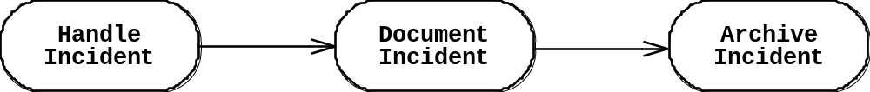
Activity Diagrams
An activity diagram is a special case of a state chart diagram
The states are activities (“functions”)
An activity diagram is useful to depict the workflow in a system
Notes:
There are two types of states:
Action state:
Cannot be decomposed any further
Happens “instantaneously” with respect to the level of abstraction used in the model
Activity state:
Can be decomposed further
The activity is modeled by another activity diagram

Slide 50
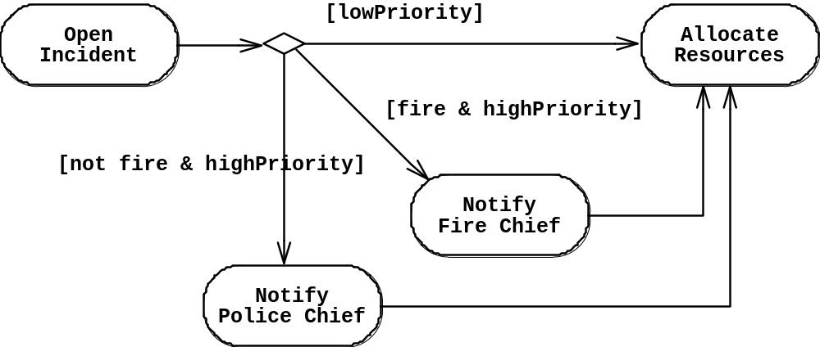
Activity Diagrams allow to model Decisions
Decision

Slide 51
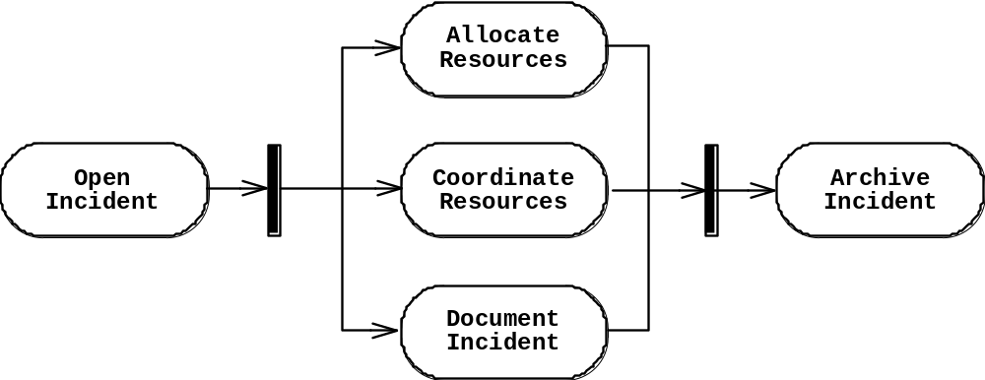
Activity Diagrams can model Concurrency
Synchronization of multiple activities
Splitting the flow of control into multiple threads
Splitting
Synchronization

Slide 52
Activity Diagrams: Grouping of Activities
Activities may be grouped into swimlanes to denote the object or subsystem that implements the activities.
Allocate
Dispatcher
Resources
Open
Coordinate
Archive
Incident
Resources
Incident
FieldOfficer
Document
Incident

Slide 53
Activity Diagram vs. Statechart Diagram
Statechart Diagram for Incident
Focus on the set of attributes of a single abstraction (object, system)
Event causes
state transition
Active
Inactive
Closed
Archived
Incident-
Handled
Incident-
Documented
Incident-
Archived
Activity Diagram for Incident
(Focus on dataflow in a system)
Completion of activity
causes state transition
Triggerless
transition
Notes:
Statechart Diagram for Incident (similar to Mealy Automaton)
Activity Diagram for Incident (similar to Moore Automaton)

Slide 54
UML Summary
UML provides a wide variety of notations for representing many aspects of software development
  Powerful, but complex
UML is a programming language
  Can be misused to generate unreadable models
  Can be misunderstood when using too many exotic features
We concentrated on a few notations:
  Functional model: Use case diagram
  Object model: class diagram
  Dynamic model: sequence diagrams, statechart and activity diagrams

